Slide 1
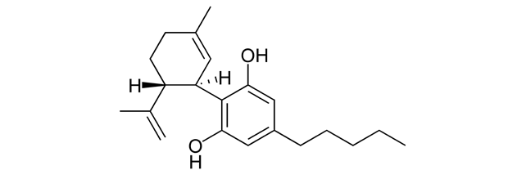
Cannabidiol inhibits paclitaxel-induced neuropathic pain through 5-HT1A receptors without diminishing nervous system function or chemotherapy efficacy

Slide 2
What is Cannabidiol(CBD)?
Cannabidiol(CBD) is one of at least 113 active cannabinoids identified in cannabis.
CBD is a key ingredient in cannabis
CBD is non-psychoactive
CBD has a wide range of medical benefits
CBD reduces the negative effects of THC
Tetrahydrocannabinol (THC) is credited with causing the marijuana high.
CBD is still illegal
http://www.leafscience.com/2014/02/23/5-must-know-facts-cannabidiol-cbd/

Slide 3
CBD vs THC
Cannabidiol (CBD) and tetrahydrocannabinol (THC) are the two main ingredients in the marijuana plant.
THC is probably best known for being the psychoactive ingredient in marijuana. CBD, however, is non-psychoactive.
THC is known to cause some people to feel anxious or paranoid. CBD works to counteract the anxiety caused by ingesting THC.
CBD seems to have antipsychotic properties. CBD may protect marijuana users from getting too high by reducing the psychosis-like effects of THC.
THC is believed to be responsible for most of marijuana’s sleep-inducing effects. CBD acts to promote wakefulness.
A pharmaceutical form of CBD, called Epidiolex, was only recently cleared by the FDA to be tested in children with severe epilepsy.
http://www.truthonpot.com/2014/09/24/5-differences-between-cbd-vs-thc/

Slide 4
CBD
Unlike psychoactive THC, CBD has little binding affinity to either the CB1 or CB2 cannabinoid receptors.
CBD indirectly stimulates endogenous cannabinoid signaling by suppressing the enzyme fatty acid amide hydroxylase (FAAH)—the enzyme that breaks down anandamide.
Anandamide binds to one or more cannabinoid receptors and is found naturally inside the mammalian brain and body. Anandamide favors the CB1 receptor, therefore CBD -> suppress FAAH -> abundant anandamide -> greater CB1 activation.
CBD also stimulates the release of 2-AG, another endocannabinoid that activates both CB1 and CB2 receptor.
At high concentrations, CBD directly activates the 5-HT1A (hydroxytryptamine) serotonin receptor, thereby conferring an anti-depressant effect.
Notes:
Russo EB, Burnett A, Hall B, Parker KK (2005). Agonistic properties of cannabidiol at 5-HT1a receptors. Neurochem Res 30: 1037–1043.

Slide 5
Medical application
Medical Properties of CBD | Effects
Antiemetic 항구토제 | Reduces nausea and vomiting
Anticonvulsant 항경련제 | Suppresses seizure activity
Antipsychotic 항정신병제 | Combats psychosis disorders
Anti-inflammatory 소염제 | Combats inflammatory disorders
Anti-oxidant 항산화제 | Combats neurodegenerative disorders
Anti-tumoral/Anti-cancer 항암제 | Combats tumor and cancer cells
Anxiolytic/Anti-depressant 항불안제 /항우울제 | Combats anxiety and depression disorders

Slide 6
Method – mechanical 1
Animals. Female C57Bl/6 mice weighing 16–20 g
All injections were given i.p. in a volume of 10 μL/g of body weight.
days 1, 3, 5 and 7 에 15분 간격으로 두 번 주사.
group 1 - CRM vehicle, CRM vehicle
group 2 - CRM vehicle, 4.0 mg·kg−1 PAC
group 3 - CRM vehicle, 8.0 mg·kg−1 PAC
group 4 - 2.5 mg·kg−1 CBD, 8.0 mg·kg−1 PAC
Group 5 - 5.0 mg·kg−1 CBD, 8.0 mg·kg−1 PAC
PAC and CBD doses were based on significant findings from Ward et al. (2011).

Slide 7
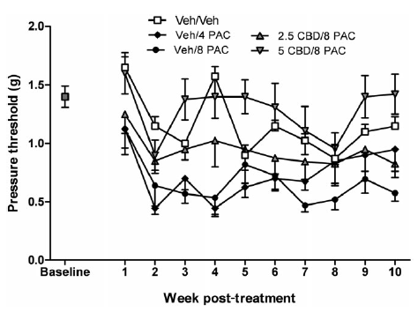
Mechanical 1 result

Slide 8
Method – mechanical 2
days 1, 3, 5 and 7 with three i.p. injections spaced 15 min apart
group 1 – saline, CRM vehicle, CRM vehicle
group 2 – saline, CRM vehicle, 8.0 mg·kg−1 PAC
group 3 – saline, 5.0 mg·kg−1 CBD, 8.0 mg·kg−1 PAC
group 4 – 1.0 mg·kg−1 WAY100635, 5.0 mg·kg−1 CBD, 8.0 mg·kg−1 PAC
Dose of WAY100635 was based on several studies investigating blockade of 5-HT1A agonist-mediated behavioural pharmacological effects (e.g. Hagiwara et al., 2008).

Slide 9
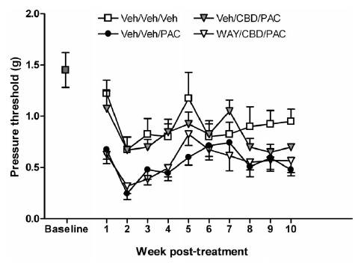
Mechanical 2 result

Slide 10
Method – mechanical 3
days 1, 3, 5 and 7 with three i.p. injections spaced 15 min apart
group 1 – saline, CRM vehicle, CRM vehicle
group 2 – saline, CRM vehicle, 8.0 mg·kg−1 PAC
group 3 – saline, 5.0 mg·kg−1 CBD, 8.0 mg·kg−1 PAC
group 4 – 3.0 mg·kg−1 SR141716, 5.0 mg·kg−1 CBD, 8.0 mg·kg−1 PAC
group 5 – 3.0 mg·kg−1 SR144528, 5.0 mg·kg−1 CBD, 8.0 mg·kg−1 PAC
Doses of SR141716 and SR144528 were based on several studies investigating blockade of CB1 and CB2 agonist-mediated effects respectively (Rahn et al., 2007; 2008).

Slide 11
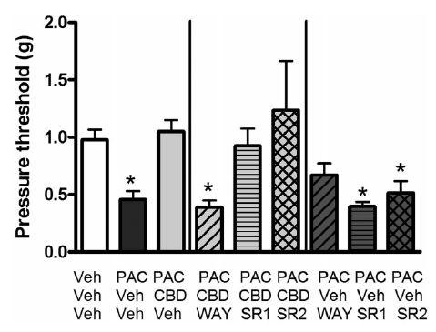
Mechanical 3 result
1.0 mg·kg−1 WAY, CRM, 8.0mg·kg−1PAC;
3.0 mg·kg−1 SR141716, CRM, 8.0mg·kg−1 PAC;
3.0 mg·kg−1 SR144528, CRM, 8.0mg·kg−1 PAC
Group 1
Group 2
Group 3
Group 4
Group 5
Notes:
suggesting CBD’s neuroprotective effect was not mediated by activation of CB1 or CB2 receptors
treatment with the antagonists alone did not further exacerbate PAC-induced mechanical sensitivity
Veh/Veh/PAC, WAY/CBD/PAC, SR1/Veh/PAC and SR2/Veh/PAC groups were statistically different from the Veh/Veh/Veh control group

Slide 12
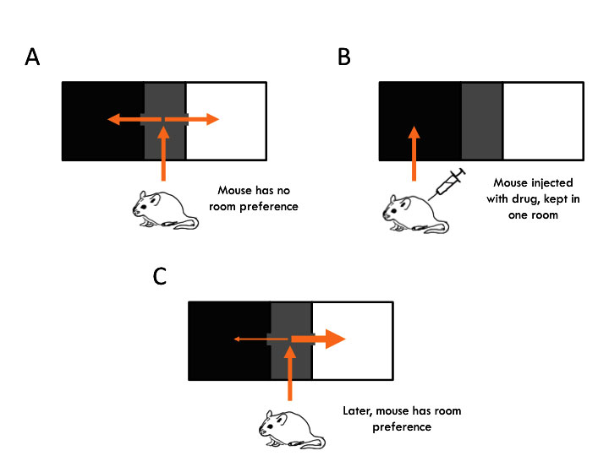
Place conditioning

Slide 13
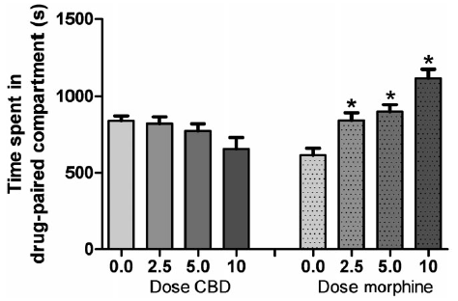
Place conditioning result
Y-axis: the time spent in the drug-paired (white) compartment on
the treatment-free test day
Notes:
in that CBD represents a cannabinoid that is regarded as being devoid of psychoactive euphoric effects
Surprisingly, however, a few preclinical studies to date have investigated CBD in reward models
Here we demonstrate that CBD does not produce a CPP

Slide 14
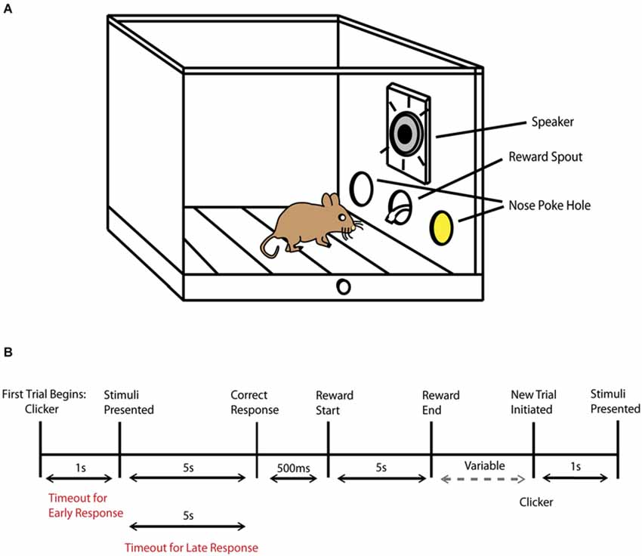
Autoshaping

Slide 15
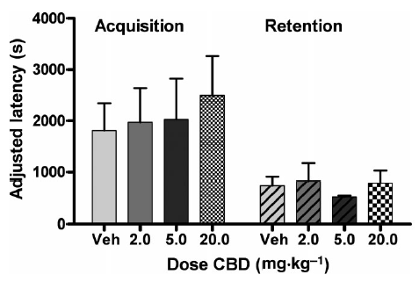
Auto shaping result
Y-axis:
the time elapsed between the first earned reinforcer and the tenth
reinforcer.
Notes:
Determination of the effect of a putative anti-CIPN pharmacotherapy on learning and memory is important because cancer chemotherapeutics themselves are associated with a form of cognitive impairment in many cancer patients also known as ‘chemofog’ or ‘chemobrain’
CB agonists are likely to exacerbate these effects, while in contrast CBD should not affect cognition, and may therefore prove to be a more tolerable alternative as an adjuvant chemotherapy agent.

Slide 16
CBD enhances PAC inhibition of breast cancer cell viability
Breast cancer cell line: 4T1(mouse), MDA-MB-231-luc-D3H2LN(human)
cultured in RPMI media containing 10% FBS.
Cells were then seeded into 96-well plates in 10% FBS and on the first day of treatment the media was replaced with vehicle control or drug(CBD, PAC) in RPMI and 0.1% FBS as previously reported

Slide 17
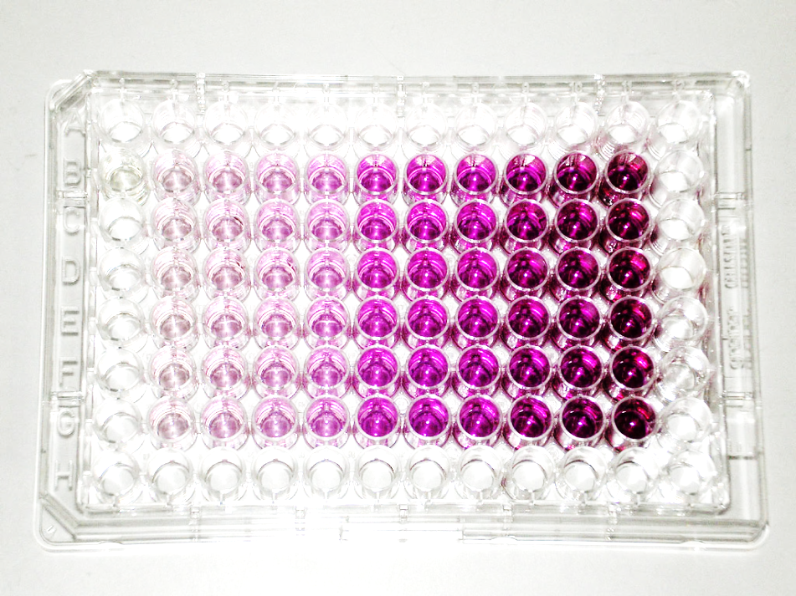
MTT assay
The MTT assay is a colorimetric assay for assessing cell metabolic activity.
NAD(P)H-dependent cellular oxidoreductase enzymes may, under defined conditions, reflect the number of viable cells present.

Slide 18
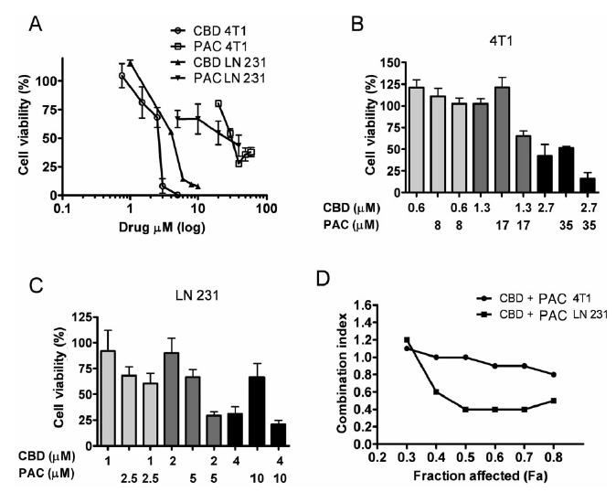
additive
(A) 4T1 and MDA-MB231-luc-D3H2LN (LN 231) cells were treated for 2 days with vehicle, CBD or PAC. Specific dose ratios of CBD
and Pac where then combined in (B) 4T1 and (C) MDA-MB231-luc-D3H2LN cells. Cell viability (%) was calculated as the MTT product absorbance
in the treated cells/control cells × 100. These data were used to calculate (D) CI values as described in Methods. A CI value of <1, 1 and >1 indicates
synergism, additivity and antagonism respectively (Chou et al., 1993). Data are the mean of at least three independent experiments; bars, ±SEM.
synergistic
Notes:
We determined that at optimal concentrations, CBD in combination with PAC produces additive to synergistic inhibition of breast cancer cell viability.
The use of higher dose ratios was limited by the solubility of PAC; however, this did not affect the calculation of a CI.

Slide 19
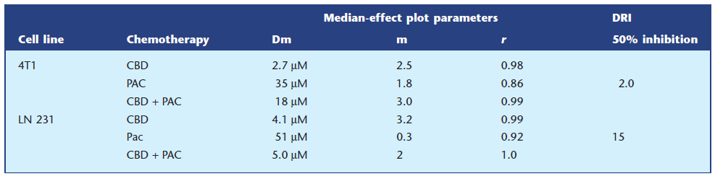
Determining optimal concentrations
The median-effect dose (Dm), slope (m), linear correlation coefficient (r) and DRI (dose-reduction index) for drugs were calculated using Compusyn.
Notes:
The use of higher dose ratios was limited by the solubility of PAC; however, this did not affect the calculation of a CI.

Slide 20
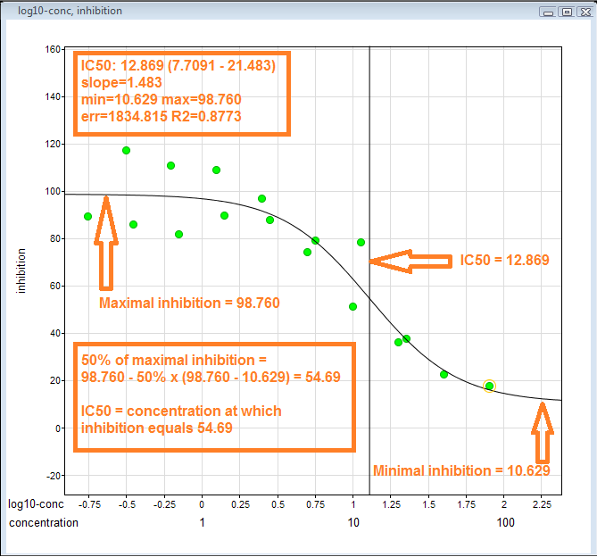
IC50

Slide 21
Relation with our experiment
CBD가 CB1, CB2가 아닌 5-HT1A receptor에 작용해서 Paclitaxel-induced neuropathic pain을 줄여준다.
Paclitaxel-induced neuropathic pain을 억제하는 기전으로 RVM의 descending inhibitory pathway가 가능함.
BV의 작용이 5-HT1A receptor와 연관이 되어 있다는 것.
따라서 BV가 5-HT1A receptor에 작용하여 Paclitaxel의 CIPN을 억제하는 기전을 생각해 볼 수 있음.

Slide 22
expression of 5-HT1A mRNA and its protein, serotonin 1A receptors is also increased in the ipsilateral lumbar spinal cord by bee venom(1)
Antisense oligodeoxynucleotide knockdown of spinal 5-HT1A receptor expression inhibited the bee venom-induced persistent nociceptive responses as well as primary heat hyperalgesia, but without affecting primary mechanical hyperalgesia, suggesting an involvement of 5-HT in the mediation of bee venom-induced pain and thermal hyperalgesia through spinal 5-HT1A receptors(1)
expression of mRNA of several serotonin (5-HT) receptors is increased including of 5-HT1A, 5-HT1B, 5-HT2A and 5-HT3 at both 1 h and 4 h after treatment. mRNA levels of 5-HT2C, 5-HT4, 5-HT6 and 5-HT7 are significantly increased in the DRG at 4 h after bee venom injection, whereas levels of 5-HT1D, 5-HT1F, 5-HT5A remain unchanged(2)
Notes:
(1)Wang W, Wu SX, Wang YY, Liu XY, Li YQ. 5-hydroxytryptamine1A receptor is involved in the bee venom induced inflammatory pain. Pain. 2003;106:135–142
(2) Liu XY, Wu SX, Wang YY, Wang W, Zhou L, Li YQ. Changes of 5-HT receptor subtype mRNAs in rat
dorsal root ganglion by bee venom-induced inflammatory pain. Neurosci Lett 2005;375:42–46.

